Slide 1
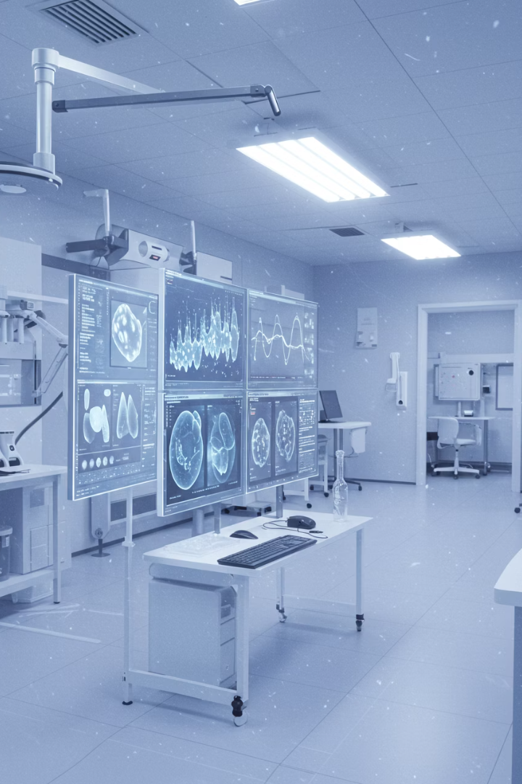

Biomedical Image Similarity Search Using Multimodal Open-Source Models
Roni Shternberg
May 2025
Biomedical Image Processing Course – Holon Institute of Technology

Slide 2
Overview
1. Project Goals and Objectives
9. Development Obstacles and Solutions
2. Similarity Search Importance
10. System Evaluation
3. System Architecture (code2flow)
11. Future Work
4. Postman App
12. Summary
5. EVICAN Dataset
6. BiomedCLIP Model
7. ChromaDB Vector Database
8. FastAPI Server

Slide 3
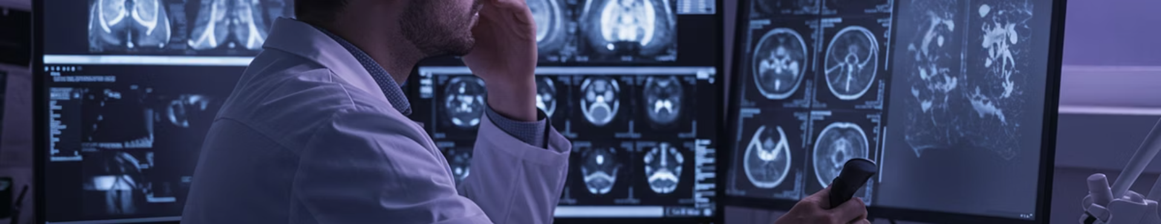




Project Goals and Objectives
1. Clinical Decision Support
2. Address Research Bottlenecks
Physicians need similar historical cases to inform diagnoses.
Manual searching through vast image repositories is inefficient.
3. Mitigating Knowledge Gap
4. Diagnostic Precision
Traditional methods rely on text metadata, missing visual similarities.
Similar image retrieval reveals subtle patterns across cases.

Slide 4




Why Biomedical Image Search Matters?
Clinical Diagnosis
Research Acceleration
Medical Education
Precision Medicine
Helps pathologists identify rare diseases by finding similar cases globally.
Enables case-based learning through visual similarity rather than text labels.
Links visual patterns to genetic markers for personalized treatment.
Connects visually similar experiments across siloed datasets.
The system aims to reduce diagnosis time significantly while improving accuracy. This creates standardized visual interpretations across institutions and brings specialized knowledge to underserved areas.

Slide 5





System Architecture Components
Interface - Postman
I use Postman app to send POST request and get result
FastAPI Server
Handle image processing and search requests
BiomedCLIP Model
Extract rich semantic image embeddings
ChromaDB Vector Database
Store and efficiently search image embeddings

Slide 6

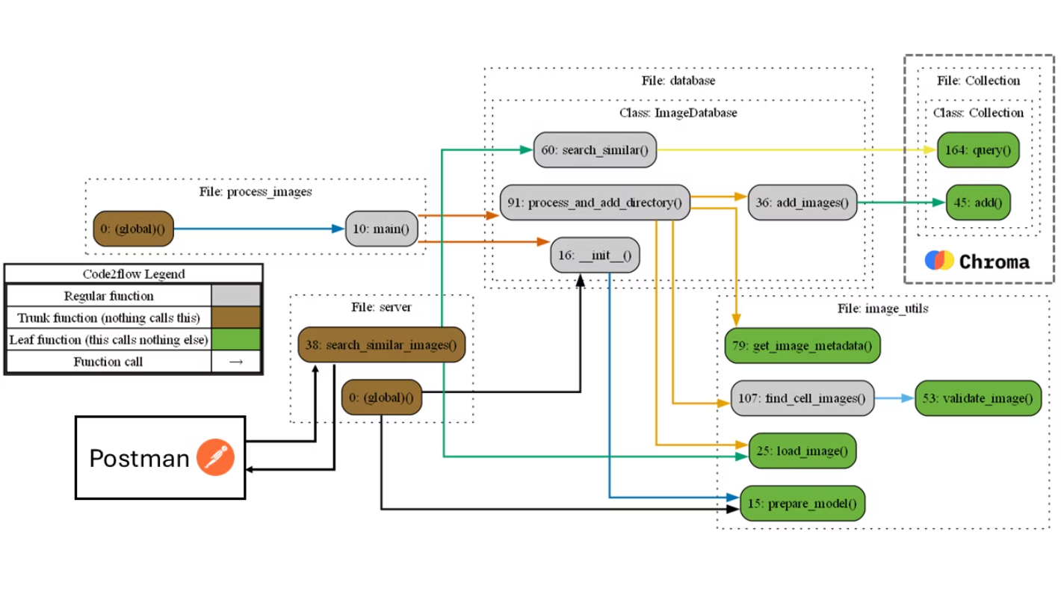
System Call Graph (using code2flow)

Slide 7
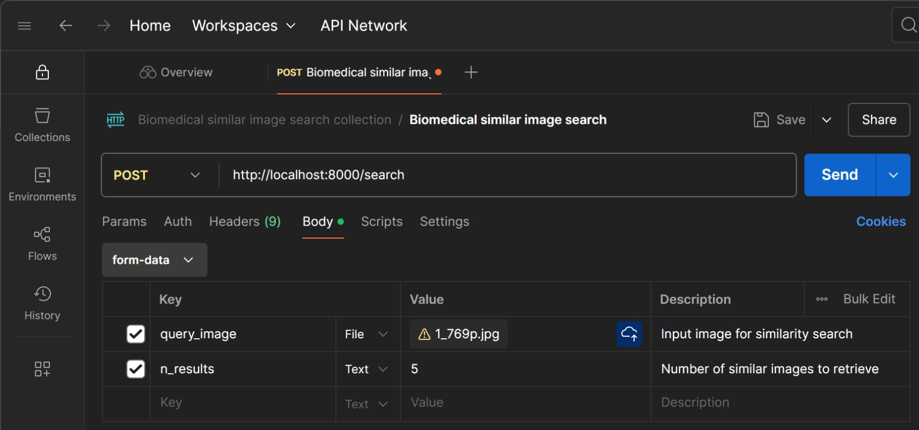
Postman App

Slide 8
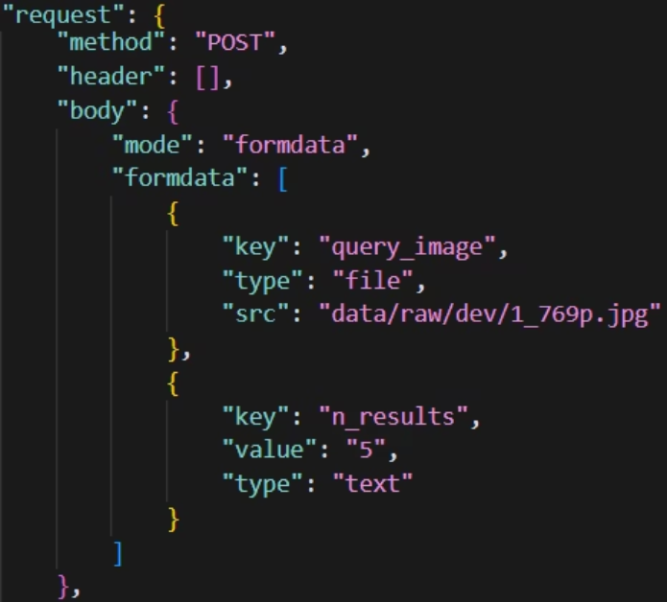
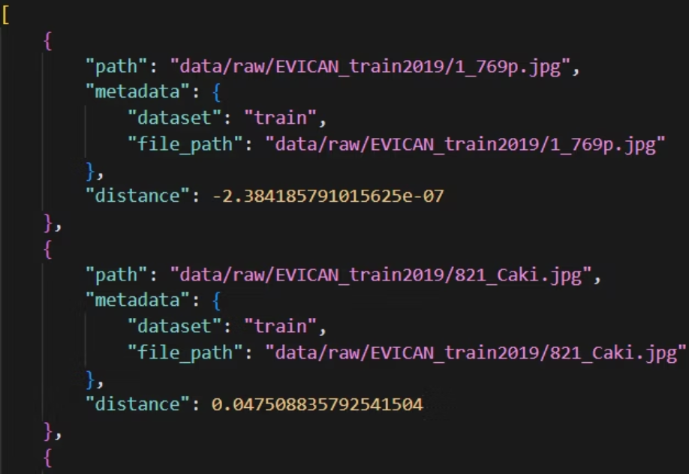
Postman: Request and Response JSON

Slide 9
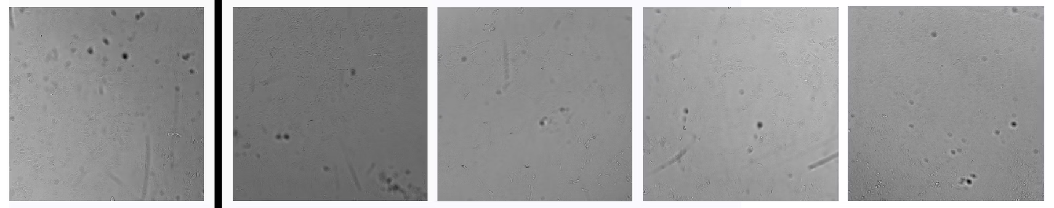
Image Comparison
Input image Output: Four most similar images

Slide 10
EVICAN (Expert visual cell annotation) Dataset
Dataset Overview
Key Features
This dataset is a specialized collection of expertly annotated cell microscopy images. It serves as a valuable resource for developing and evaluating machine learning models in biomedical image understanding.
Multiple cell types and imaging modalities
Expert-driven annotations for ground truth
Diverse cellular structures and morphologies
Research Applications
Comprising annotated grayscale images of 30 different cell lines from multiple microscopes, contrast mechanisms and magnifications. With 4600 images and ∼26 000 segmented cells, it offers diverse cellular representations.
This dataset enables advancements in areas like cell classification, morphological analysis, and anomaly detection.
It supports multi-modal learning and transfer learning for specialized cellular analysis.

Slide 11
The Model: BiomedCLIP (Biomedical Contrastive Language-Image Pre-training)
Domain Specialization
Multimodal Understanding
Transfer Learning
Architecture
The model uses a Vision Transformer backbone for robust feature extraction, along with a PubMedBERT text encoder for biomedical language understanding.
BiomedCLIP is pre-trained on PMC-15M, containing 15 million figure-caption pairs from biomedical research articles, allowing it to deeply understand cellular structures and medical concepts.
The model connects visual features with biomedical terminology, enabling both image-to-text and text-to-image retrieval.
BiomedCLIP captures domain-specific visual features, requiring fewer examples to fine-tune for specialized biomedical tasks.

Slide 12
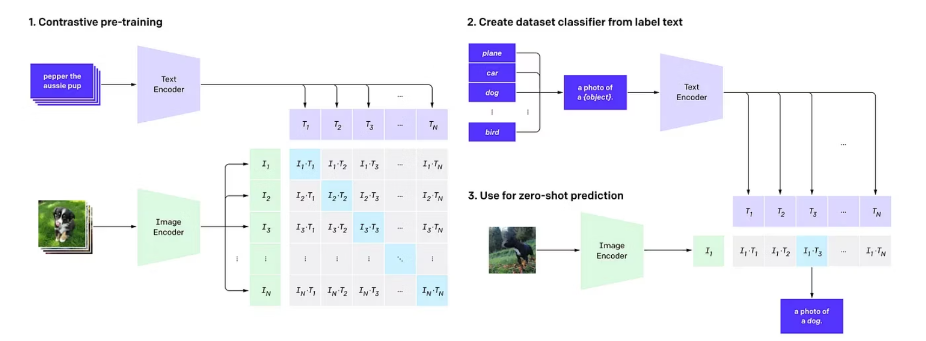
CLIP - Image Embedding Generation Process
CLIP pre-trains an image encoder and a text encoder to predict which images were paired with which texts in our dataset. We then use this behavior to turn CLIP Into a zero-shot classifier We convert all of a dataset's classes into captions such as "a photo of a dog" and predict the class of the caption CLIP estimates best pairs with a given image.

Slide 13
System - Image Embedding Generation Process
Image Preprocessing
Images loaded and converted to RGB format, resized and normalized.
Feature Extraction
BiomedCLIP encoder extracts 512-dimensional feature vectors.
Embedding Normalization
Vectors normalized for consistent similarity comparison.
# Extract embeddings with torch.no_grad(): features = model.encode_image(img_tensor, normalize=True) # Convert to numpy array query_embedding = features.cpu().numpy().squeeze()

Slide 14
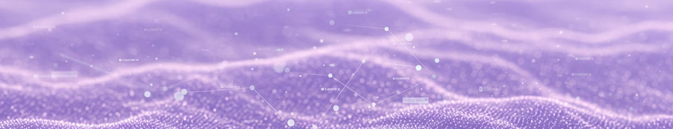




ChromaDB Implementation
Persistent Storage
Fast Search
Similarity Metrics
Batch Processing
Approximate nearest neighbor search with HNSW index.
Durable storage of embedding vectors and metadata.
Cosine similarity for comparing embeddings.
Efficient database population and query handling.

Slide 15



FastAPI Server API Design
RESTful API
Endpoints for image upload and similarity search
Asynchronous Handling
Efficient request processing and response generation
Input Validation
Error handling and secure file management

Slide 16





End-to-End Image Search Process
Query Submission
User uploads image through API
Image Processing
Temporary storage, preprocessing and normalization
Feature Extraction
BiomedCLIP generates embedding vector
Similarity Search
ChromaDB finds nearest neighbors in embedding space
Result Processing
Similar images ranked by distance

Slide 17
Development Obstacles and Solutions
Image Heterogeneity
Computational Efficiency
Scalability Concerns
Challenge: Diverse biomedical image formats and characteristics.
Challenge: Processing large datasets with deep neural networks.
Challenge: Handling growing image collections.
Solution: Robust image validation and preprocessing pipeline.
Solution: Batch processing with configurable batch sizes.
Solution: Vector database with approximate nearest neighbor search.

Slide 18
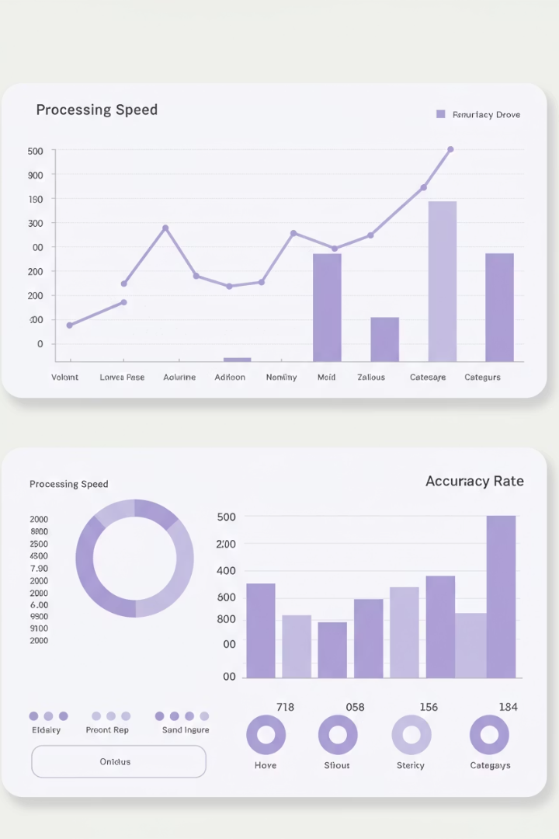
System Evaluation
<500ms
Linear
Query Time
Scaling
Average search speed for database of thousands of images
Performance scaling with database size due to HNSW indexing
High
Precision
Retrieval accuracy on known similar images
Retrieved images show biological relevance beyond visual similarity, capturing semantic relationships between cell types.

Slide 19







Future Work
Clustering
Multimodal Queries
Hierarchical organization of embedding space
Text + image search capabilities
Dataset Expansion
4
Active Learning
Incorporating additional biomedical collections
Feedback loop to improve search results

Slide 20
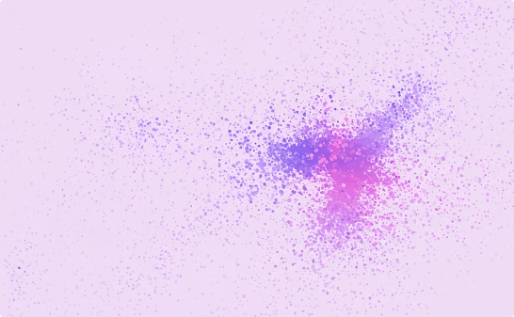

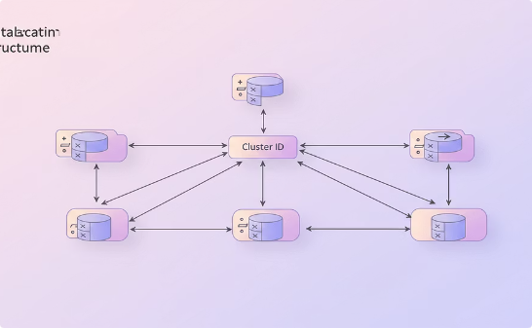
Future Work - Clustering
Dimensionality Reduction
Hierarchical Clustering
Metadata Updates
UMAP transforms high-dimensional embeddings for visualization.
AgglomerativeClustering groups similar images with distance threshold.
Database entries enriched with cluster information.

Slide 21

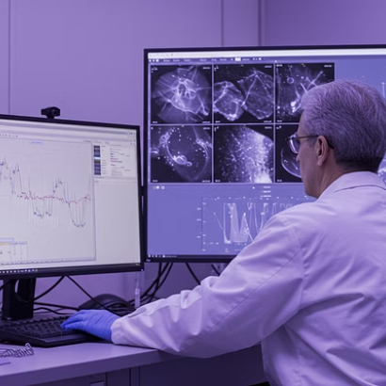
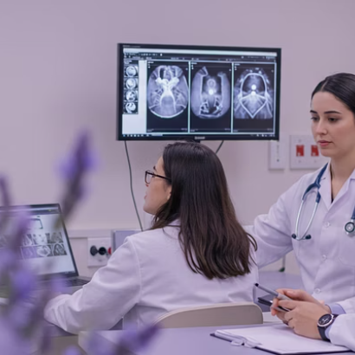

Summary
Key Achievements
Broader Impact
Next Steps
End-to-end biomedical image search system using state-of-the-art models with scalable architecture.
Accelerates research, provides foundation for automated analysis, demonstrates AI in healthcare.
Open source contribution, integration with medical systems, extension to new domains.

Slide 22
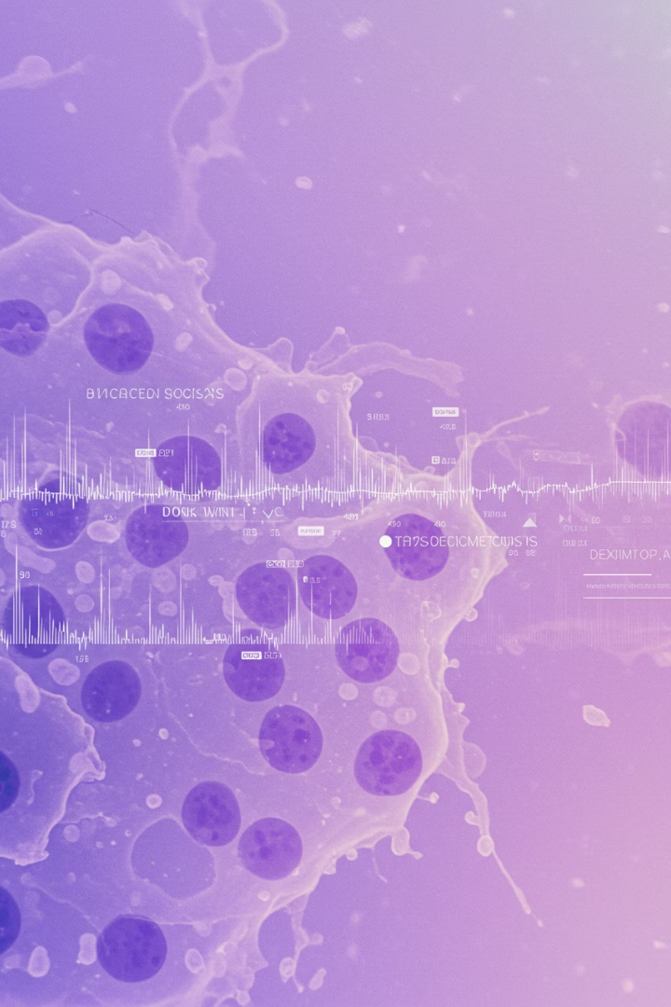
Thank you!
Questions?

